Slide 1
FILE and FILE MANAGEMENT

Slide 2
FILES
Files are the OS mechanism for saving information from one session to another.
A file is a logical storage unit defined by the O.S, providing the user a mechanism to store INFO on a physical storage devices such as disk , tape , CD and etc.
File abstracts storage devices.

Slide 3
WHY FILES ?
Possible to store large amount of INFO
INFO survives after termination of any process
Multiple processes can access INFO concurrently

Slide 4
File system
A file system is a way of organizing information on a storage device like a computer hard drive.
The part of the operating system dealing with files is known as the file system.
The file system is the component of O.S. that manipulate the INFO as files and directories
Eg ?

Slide 5
File management.
Provide the abstraction.
File creation and deletion and naming.
Directory creation and deletion.
Support for manipulating files and directories.
Mapping files onto secondary storage
Identify and locate a selected file
Provide protection mechanism that allows users to administer how the files can be accessed by other users.

Slide 6
User’s point of view.
How it appears to them.
What constitutes a file
How files are named
How files are protected
What operations are allowed

Slide 7
File naming
The exact rules for file naming vary somewhat from system to system-many supports up to 255 characters now.
Some O.S. recognize difference between upper and lower case letters ( e.g., Unix) and some of them don’t (e.g., MS-DOS)
The file extension usually indicates what type of file it is (see the next slide). In some systems (e.g., UNIX), file extension are just conventions and are not enforced by O.S. Some other systems (e.g., Windows) are aware of extension and use programs that are assigned to the extensions (e.g., file.doc starts Word)

Slide 8
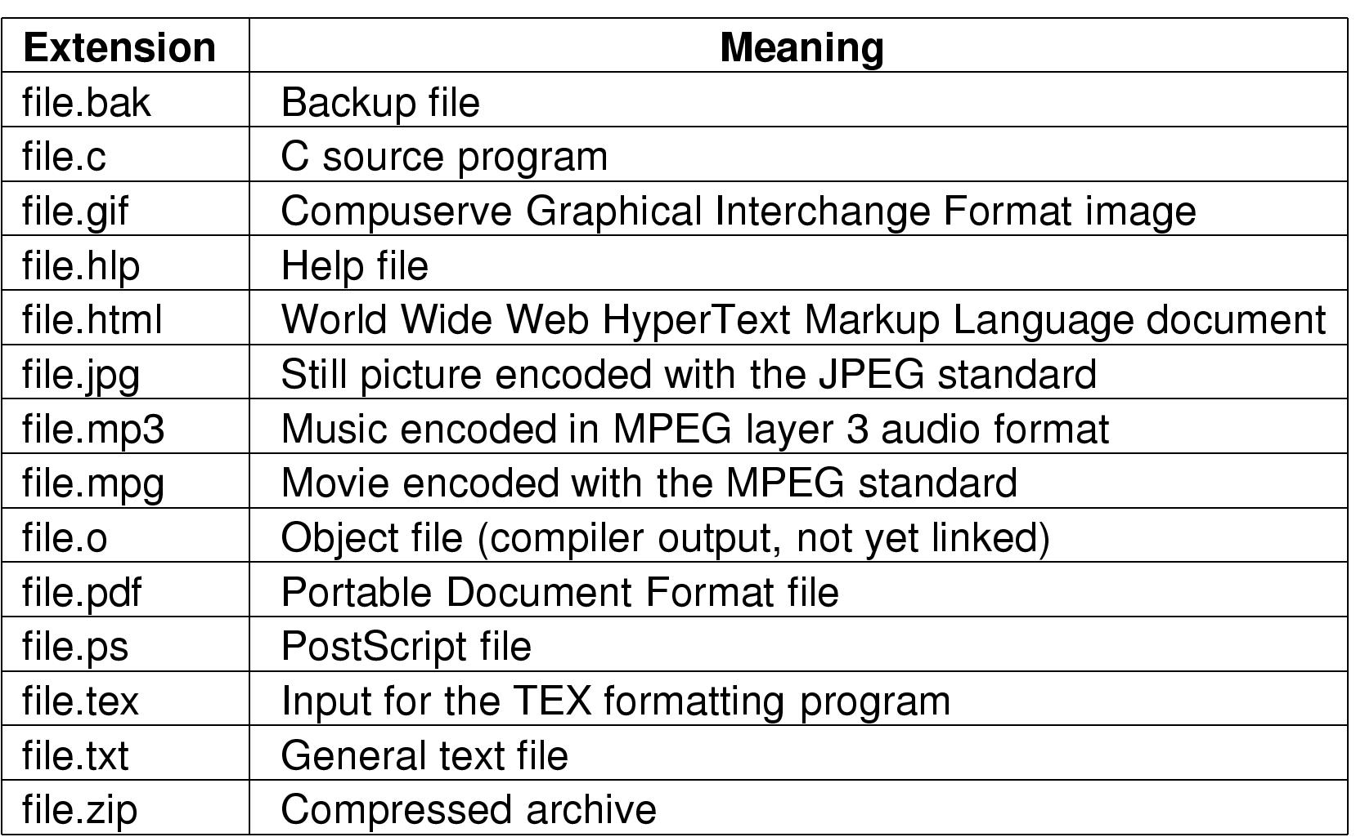
Extensions..

Slide 9
File types
Many OS support several types of files.
UNIX and WINDOWS have regular files and directory files.
UNIX also has special files(device files)

Slide 10
Regular files
Regular/ordinary file, used to store info and data on secondary storage device, typically a disk.
It can contain a source program, an executable program such as compilers, DB tools, pictures, audio, graphics, and so on.
Unix does not treat any kind of these files differently from others. For example a C++ file is no different to UNIX than an HTML file, however the files are treated differently by C++ compiler and WEB browser.
Regular files are generally either ASCII files or binary files.

Slide 11
Directory Files
Directory file contains the name of other files and/or directories (sub directory).
Directories are the mechanism provided by O.S. to keep track of files.
Directory typically contains one entry per file. It may contain Name, Attributes and Location or
It may contain Name and pointer to Attribute information
Directories have names just like other files, and these names obey the same naming rules as normal files.
A directory is a place within the file system as a whole that contains files. You can construct filenames that include a directory as part of the name. The slash ‘/’ char is used to separate the different components of a file name of this form.

Slide 12
Directory files cont..
A directory is used to store a record for each file or subdirectory it contains.
This record (also called directory entry) consists of the file inode number and the file name.
inode (index node) is a 4 byte number and is an index for an array on the disk.
An element of this array contains file attributes such as file size.
How to identify regular files and directory files???
What is . And .. ????

Slide 13
Special files (devices)..
Special files (devices), it is a mean of accessing hardware device, including the keyboard, hard disk, CD-ROM drive…etc.
Each hardware device is associated with at least one special file.
A command or an application accesses the special file in order to access the corresponding device.
There are two types: a character special file for a char oriented devices such as for keyboard and block special file for block oriented devices such as a disk.
Usually they reside in the /dev directory
How to identify special files???

Slide 14
File Access
Generally two types of access are provided for the files :
Sequential access: starts from the beginning and read sequentially (usually is using with tapes)
Random access: can access any byte in the file directly.
O.S. provides these operations to the user

Slide 15
File Attributes
OS associates many information's with every files created, such as
Location: where the file is physically located
Size: how big is the file
Type : what kind of file it is
Protection: who can access the file
Time & Date: when was the last access or modification
User: who created the file
and other information. Some of the attributes are shown in the next slide

Slide 16
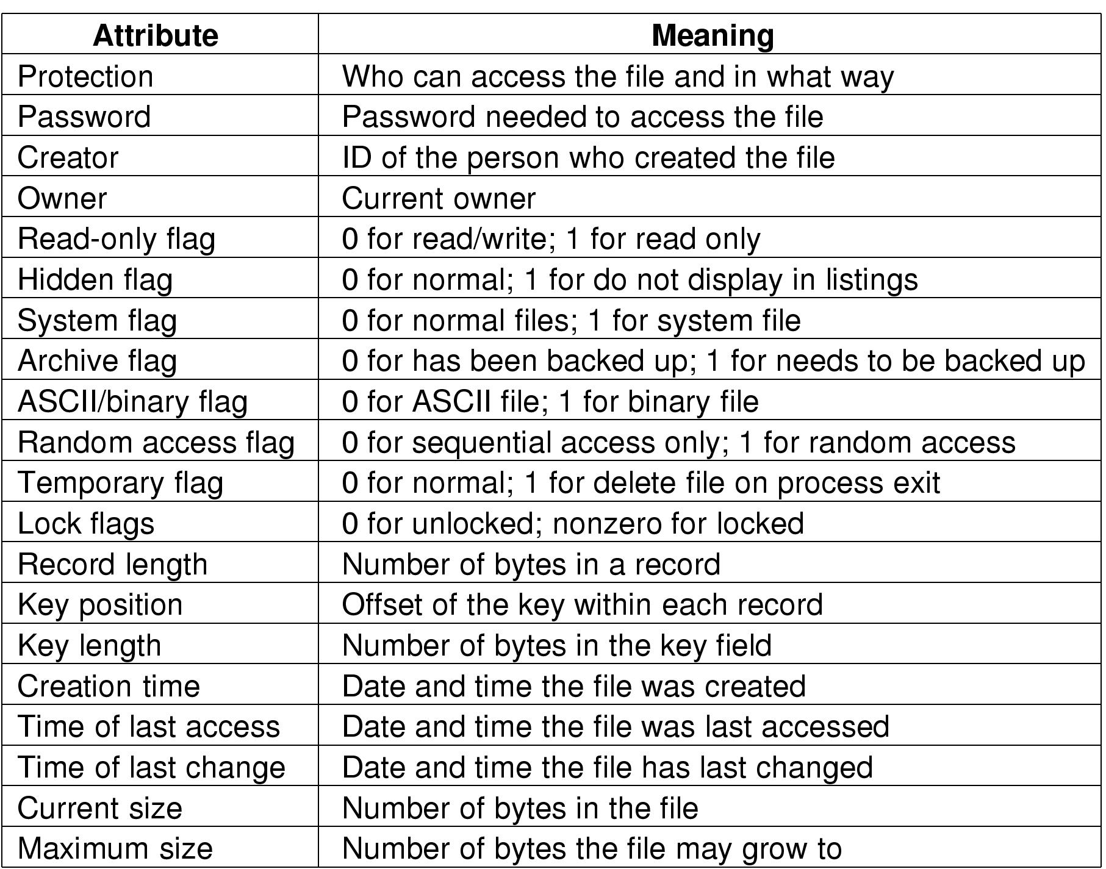
HOW TO SEE??

Slide 17
Cont..
ls -l option to get a long listing that gives the attribute of files.
  first letter is for file type.
  access permission, user, group, and others.
  number of links.
  owner’s login name.
  owner’s group name
  file size in bytes.
  date, time of last modification.
  file name.

Slide 18
File Operations
Most common system calls relating to files
Create: announce that file is coming and set attributes and allocate space
Delete: Free disk space, adjust directory structure
Open : Fetch the attributes and location of the file
Close: Release internal table space and writing the file’s last block

Slide 19
Cont..
Read: Data read from the file and put into memory for user access
Write: Data are written to the file usually at the current position
Append: Adds data to the end of file
Seek: Random access data from the file, repositioning the file pointer for reading
Rename: Change the name of the file
Get & Set attribute: Get attributes of file or set attributes of a file (e.g., get and set read only attribute )

Slide 20
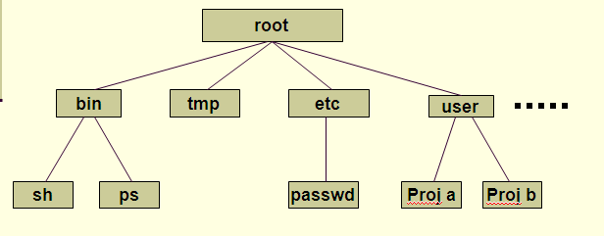
File System Structure(directory structure)
The UNIX file system is structured hierarchically upside down treelike, so it start with root directory and can have any number of files or sub directories under it. A typical UNIX system contains hundreds of files and directories, organized as the following

Slide 21
Cont..
The structure starts at the root level
  Root is the name of the file at this basic level and it is denoted by the slash character (/)
A directory is a file that can contain other files and directories
A subdirectory is a directory within a directory
  The subdirectory is considered the child of the parent directory
  Windows directory structure ? Rooted tree ??

Slide 22
Understanding Paths and Pathnames
To specify a file or directory, use its pathname, which follows the branches of the file system to the desired file
  A forward slash (/) separates each directory name (windows ??)
  The UNIX command prompt may indicate your location within the file system
  Use the UNIX pwd command to display the current path name
To navigate the UNIX directory structure, use the cd (change directory) command
UNIX refers to a path as either:
  Absolute - begins at the root level and lists all subdirectories to the destination file
  Relative - begins at your current working directory and proceeds from there

Slide 23
Directory Operations
Create : creates (mkdir) . , ..
Delete : only empty directory can be deleted (rmdir)
Rename
Opendir
Closedir
Link & unlink: link is a common technique used for sharing files or directories between users

Slide 24
Implementing files and directories

Slide 25
File System –the Logical view
Why file system ?
To access data in low-level format is cumbersome
  Need to know about tracks and sectors
OS provides a uniform logical view of information storage via the File-System
A file is nothing more than a sequence of bytes
A file is stored in one or more blocks on disk
A block is the unit of transfer between Memory and Disk.
  A block comprises of one or more sectors of the disk
File system deals at the block level. Eg. Read block 123, write block 123 etc..
  Device drivers map the block no’s to track/sector no.

Slide 26
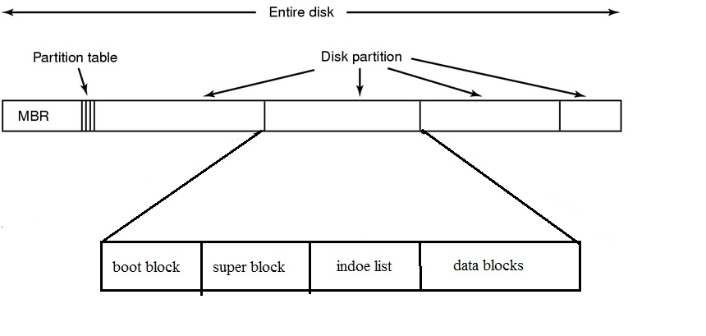
Basic file system lay out.
A possible file system layout

Slide 27
File System Layout
Most disks can be divided up into one or more partitions, with independent file systems on each partition.
Sector 0 of disk is called MBR ( Master Boot Record) which is used to boot the computer.
The end of the MBR contains the partition table which gives the starting and ending address for each partition.
One of the partition in the table is marked as active.
When the computer is booted, BIOS reads in and executes the MBR.
The first thing the MBR pgm does is locating the active partition and read its first block called the boot block and execute it. The pgm in the boot block loads the OS contained in that partition,

Slide 28
Cont..
For uniformity , every partition start with a boot block, even if it doesn’t contain a bootable OS (reserved for future)
Other than starting with the boot block , the lay out of the partitions varies strongly from file system to file system.
Superblock- describe the state of file system- how large is, how many files it can store, where to find the free space, how many inodes are possible...
Inode list- list of inods.
Data blocks- contains file’s data.

Slide 29
Implementing files- unix
INTERNAL REPRESENTATION OF FILES.
INODES- every file on a UNIX system has a unique inode.
contains the information necessary for a process to access a file.
consists of file owner identifier, file type, file access permissions, location of the files data in the file systems, file size etc
Processes access files by a well defined set of system calls by specifying the file by a character string, that is the path name.
Each path name uniquely specify a file , and the kernal converts the path name to the files inode.

Slide 30
inodes
Where exactly inode is stored ?
  Inode exits in a static form on disk and the kernel reads them into an in-core inode to manipulate them
Disk inodes consist of following fields.
- file owner identifier
- file type
- file access permissions
- file access times
- number of links to the file
- table of contents for the disk address of data in a file
- file size

Slide 31
inodes
in-core copy of the inode contains
  The status of the inode, indicating whether
    The inode is locked,
    Process waiting for inode to become unlocked
    In-core representation is changed from the disk copy.
  logical device number of file system
  inode number
  pointers to other in-core inodes
  reference count

Slide 32
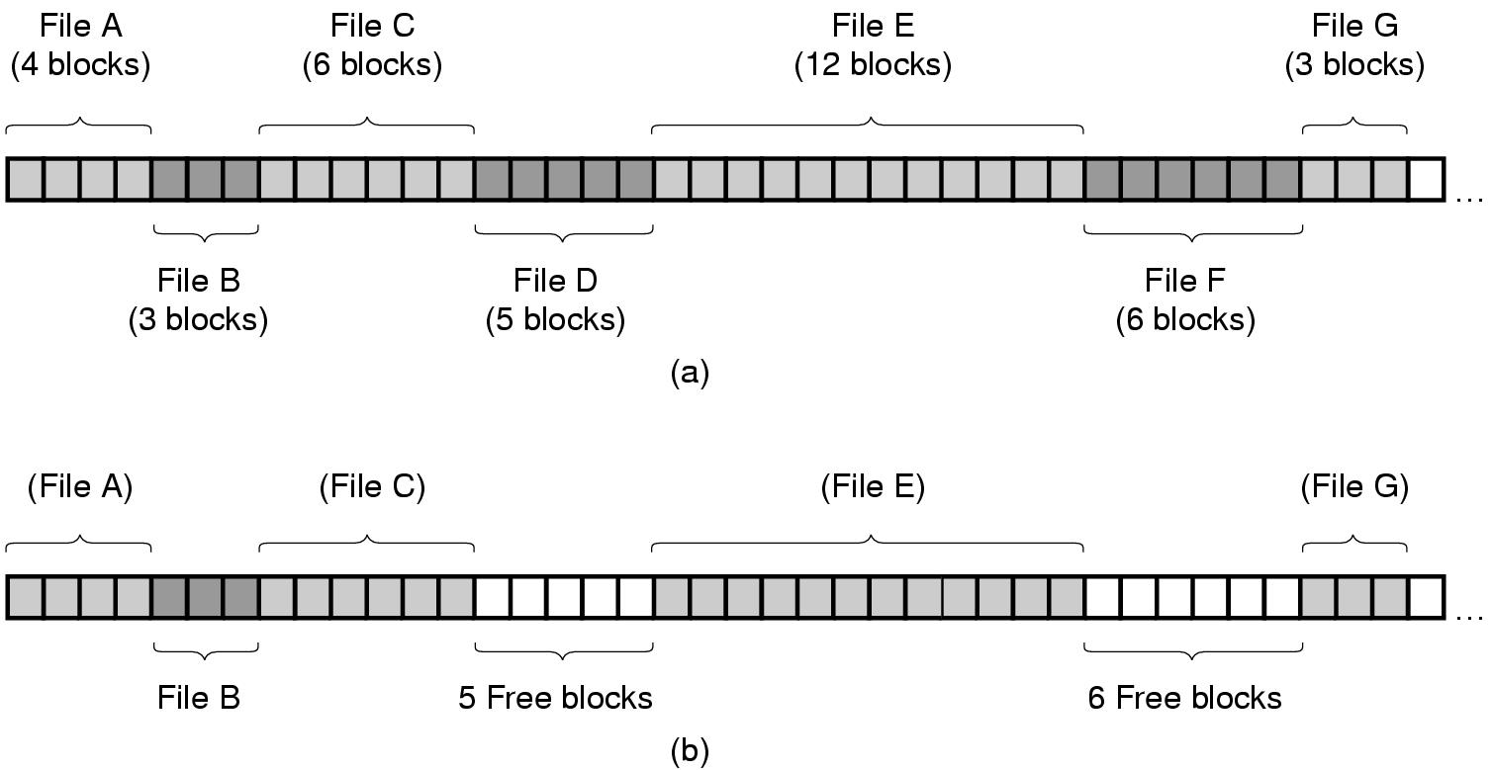
Implementing the Files(storage allocation strategies)
How exactly files are organized in blocks??
Contiguous Allocation: Each file is stored on consecutive disk blocks. For example for a disk with 4K block size, a 20K file is stored on 5 consecutive blocks.

Slide 33
Contiguous Allocation
what will be inside the inode ??
simple to implement because we need to know only disk address of the first block and number of blocks
The read performance is excellent because we need only one disk operation to read the entire file.
But ..
Disk fragmentation: happens when the files are removed. Compaction is difficult because all the blocks following the holes should be copied. It is worse when the disk filled up.
Needs to know the final size of new file to be able to choose the correct hole to place it. That is also difficult
Consecutive allocation is good for write once medias such as CD-ROMS and DVDs

Slide 34
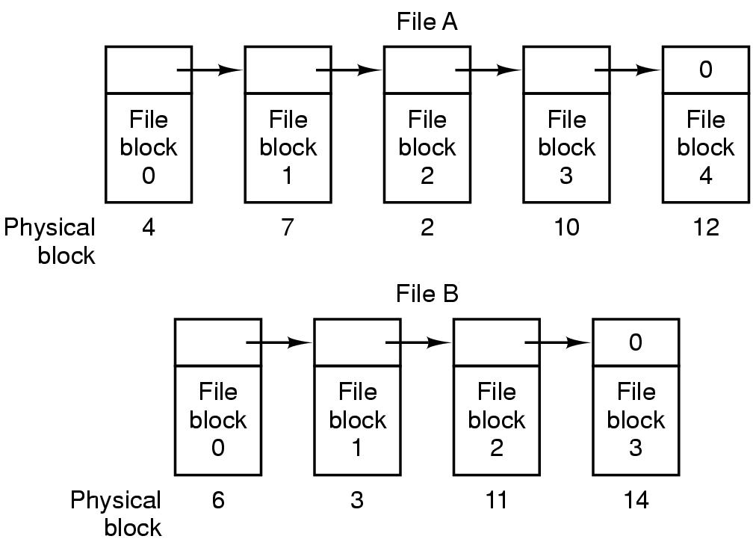
Linked List Allocation
A linked list of disk blocks (first word is pointer) is kept in this method
Every disk blocks can be used (except for internal fragmentation)
The sequential read for the blocks of the file is easy but random access to each block is hard because we have to read all the blocks of a file before that block

Slide 35
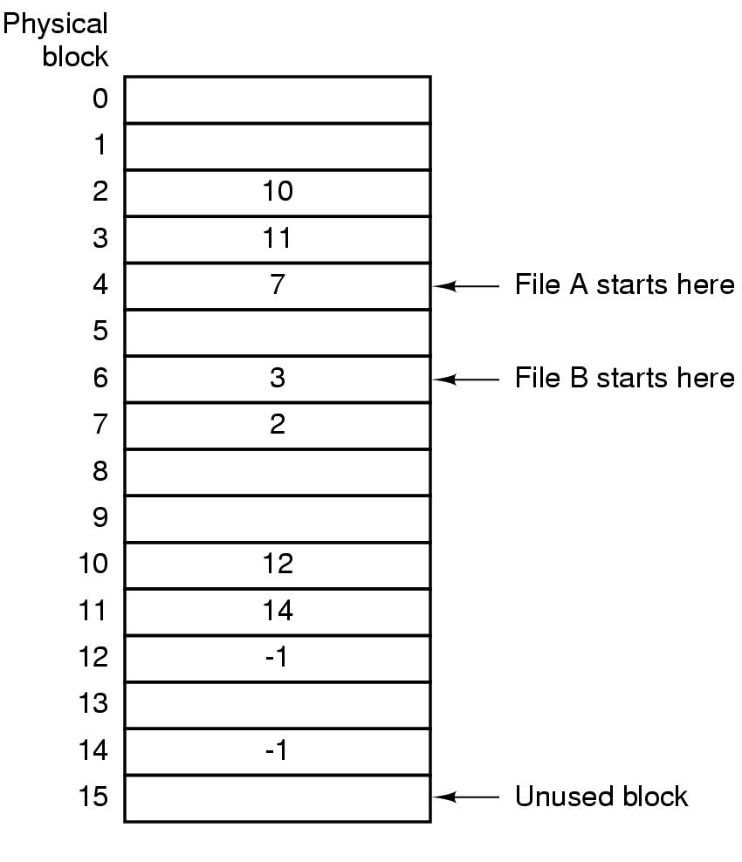
Linked List Allocation using a Table in Memory(fat)
Both of disadvantages of the linked list allocation can be eliminated by keeping the table of pointer to the blocks (FAT) in the memory. MSDOS uses that
.
Random access to blocks is easy because there is no disk reference involved
The problem is for 20 GB disk, and a 1 KB block size table needs 20 million entries if each be 4 bytes, table will take approximately 80 MB

Slide 36
Unix indodes
Inodes contains attributes and disk address of the blocks of that file. So if i-node occupies n bytes for k files open we have kn bytes of memory. Thus i-node depends on open files not disk size
But since each inode has room for a fixed number of disk addresses what happens when a file grows beyond this limit?
i-node in V UNIX has
Initial 10 disk addresses.
Single indirect blocks keeps address of file more blocks for larger files.
Double indirect block that holds address of the blocks each contains a list of single indirect block
Triple indirect block has the address of block each is double indirect block

Slide 37
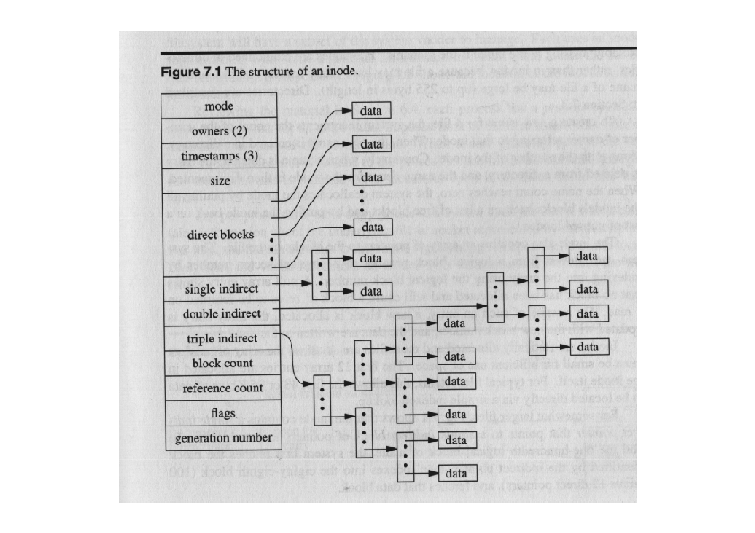
V UNIX INODE

Slide 38
IMPLEMENTING DIRECTORY
Directories are the files that give the file system its hierarchical structure.
It plays an important role in conversion of a file name to its inode number.
A directory is a file whose data is a sequence of entries, each consisting of an inode number and the name of a file contained in the directory
Path name is a null terminated character string divided by slash (“/”)
Each component except the last must be the name of a directory, last component may be a non-directory file

Slide 39
Directory structure
Byte Offset in Directory | Inode Number | File name
0 | 83 | .
16 | 2 | ..
32 | 1798 | init
48 | 1276 | fsck
64 | 85 | clri
80 | 1268 | motd
96 | 1799 | mount
Lay out of directory / etc
. And .. ??

Slide 40
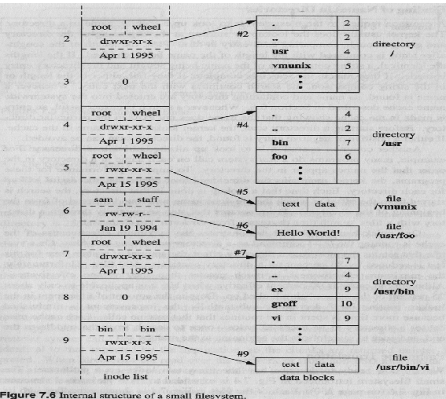
Detailed view

Slide 41
Cont..
Kernel stores data for directory just as it stores the data for an ordinary file using inode structure and levels of direct and indirect blocks.
Processes read the directories in the same way they read regular files.
Read , write , execute permission ??
Read allows read the directory entries
Write to create new directory entries (kernal reserves the exclusive write access)
Execute ?? Allow the processes to search inside the directory files.

Slide 42
Path name to inode
Initial access to a file is through its pathname. The kernel needs to translate a pathname to inodes to access files.
The algorithm namei parses the pathname one component at a time, converting each component into an inode based on its name and the directory being searched and eventually returns the inode of the input path name.

Slide 43
Example: Finding /usr/bin/vi
/usr/bin/vi => i-node of /usr/bin/vi
Get the root i-node:
  The i-node number of ‘/’ is pre-defined (#2)
Use the root i-node to get to the ‘/’ data
Search (usr, i-node#) in the root’s data
Get the usr’s i-node
Get to the usr’s data and search for (bin, i-node#)
Get the bin’s i-node
Get to the bin’s data and search for (vi, i-node#)
Get the vi’s i-node, find data block
Permissions are checked all along the way
  Each dir in the path must be (at least) executable

Slide 44
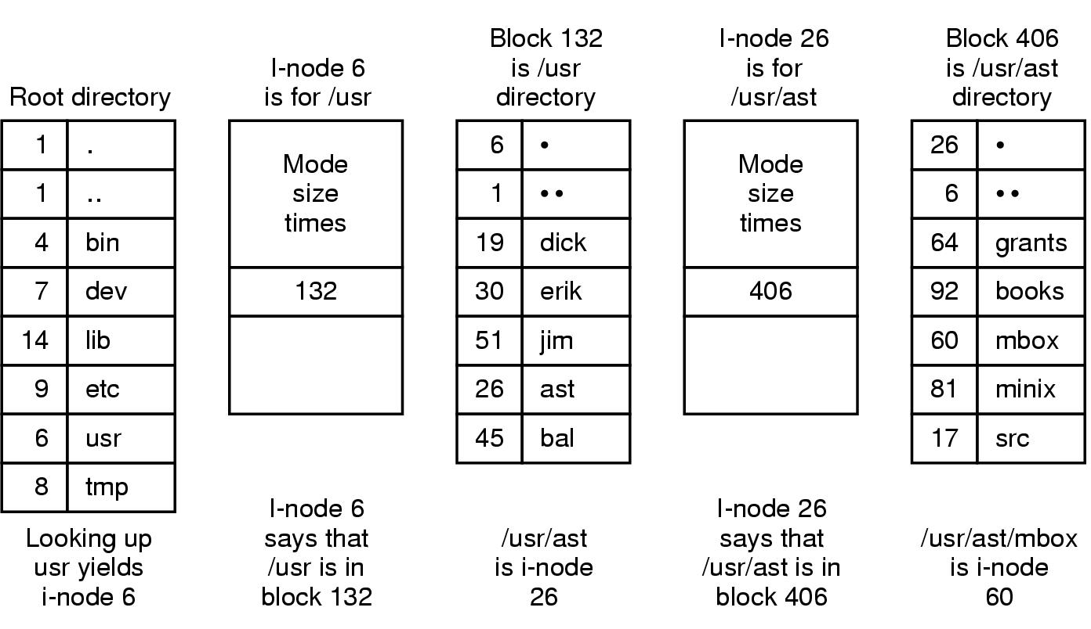

Slide 45
4.5 Super block
File System
consists of
- the size of the file system
- the number of free blocks in the file system
- a list of free blocks available on the file system
- the index of the next free block in the free block list
- the size of the inode list
- the number of free inodes in the file system
- a list of free inodes in the file system
- the index of the next free inode in the free inode list
- lock fields for the free block and free inode lists
- a flag indicating that the super block has been modified
boot block super block inode list data blocks

Slide 46
Further reading
Modern Operating System- Andrew S Tanenbaum
The Design of the Unix Operating System
- Maurice J Bach

